Slide 1
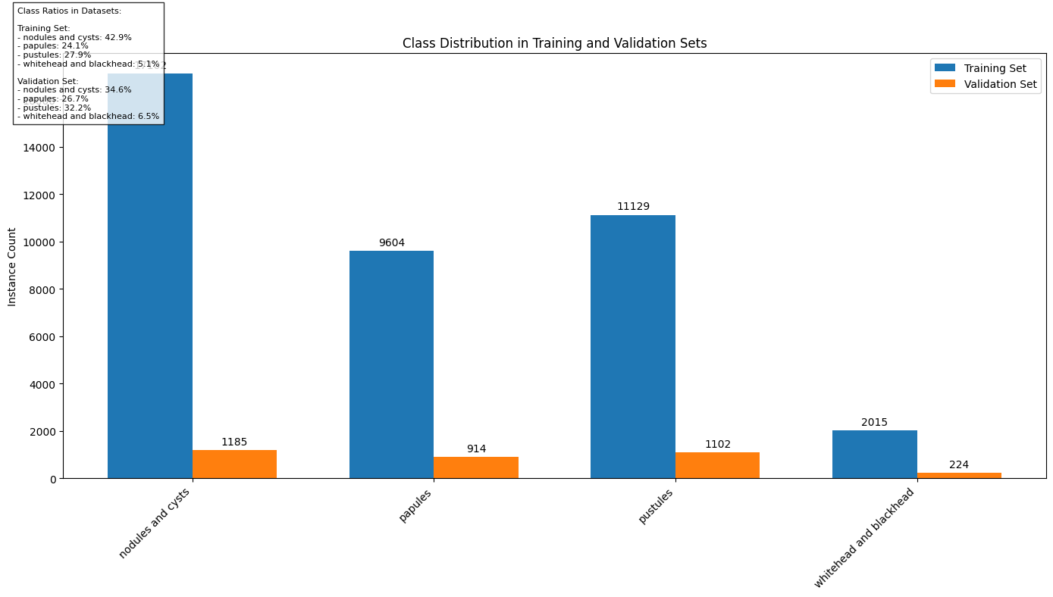
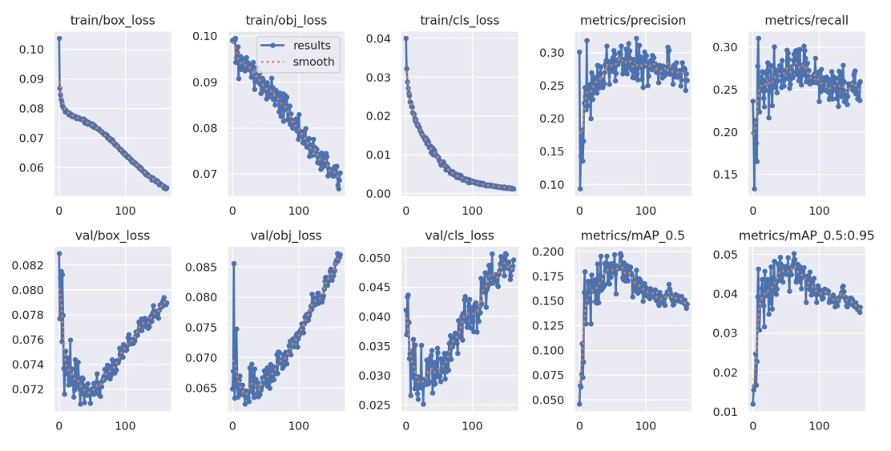
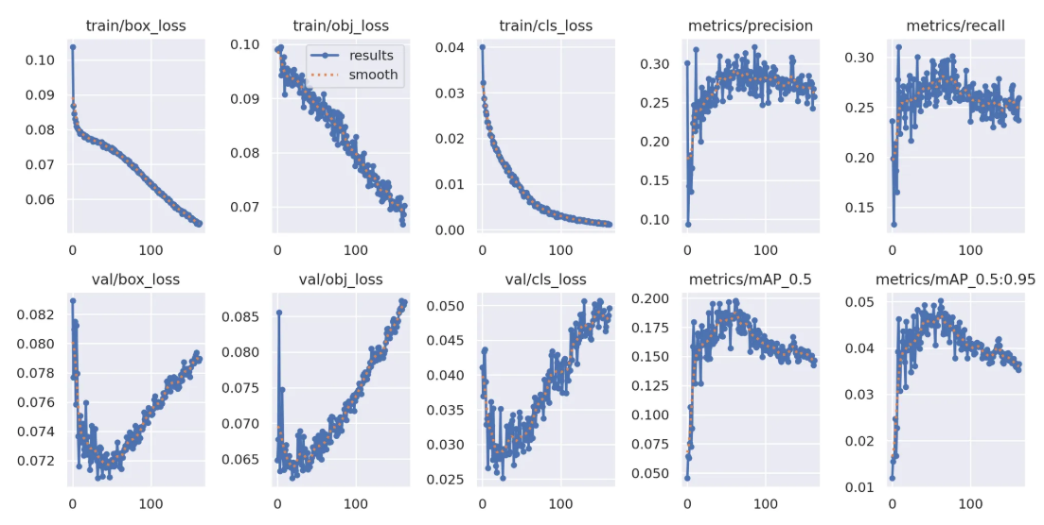
Yolov5 - Training
Result Conclusion
Dataset Statistics
Data imbalance: whitehead and blackhead(5.1%), nodules and cysts(42.9%)
Data augmentation : Added data augmentation configurations to the original data.yaml, including: hue (hsv_h) shift by 0.015, saturation (hsv_s) shift by 0.7, value (hsv_v) shift by 0.4, as well as rotations up to 10 degrees and translations by 10% of the image size, aiming to enhance data diversity.
Motivation:
Address insufficient data: Synthesize new samples to expand the diversity of training data and alleviate the overfitting problem in small datasets.
Enhance generalization ability: Enable the model to learn more robust features (such as color - invariant features, multi - angle features), so that it can perform better on unseen images during testing.
Cope with real - world scenario challenges:
Lighting changes (HSV augmentation)
Angle diversity (rotation, translation)
Small target detection (Mosaic)
Anchors choosing: Acne detection targets are small, reduce the size of the anchors to better detect small objects.
Model selection(yolov5s/yolov5m):
YOLOv5s (small): lightweight and fast, suitable for limited hardware environments or real-time applications.
YOLOv5m (medium): a balanced model with better accuracy at the cost of slightly more computation.
a) Yolov5s
Training log
b) Yolov5m

Slide 2
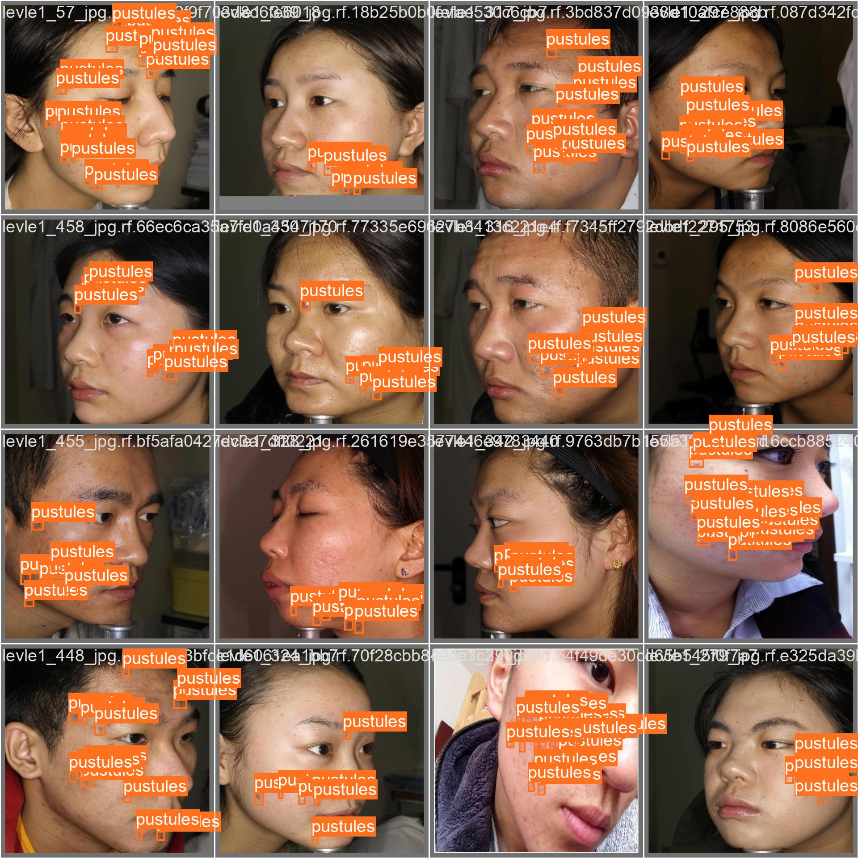
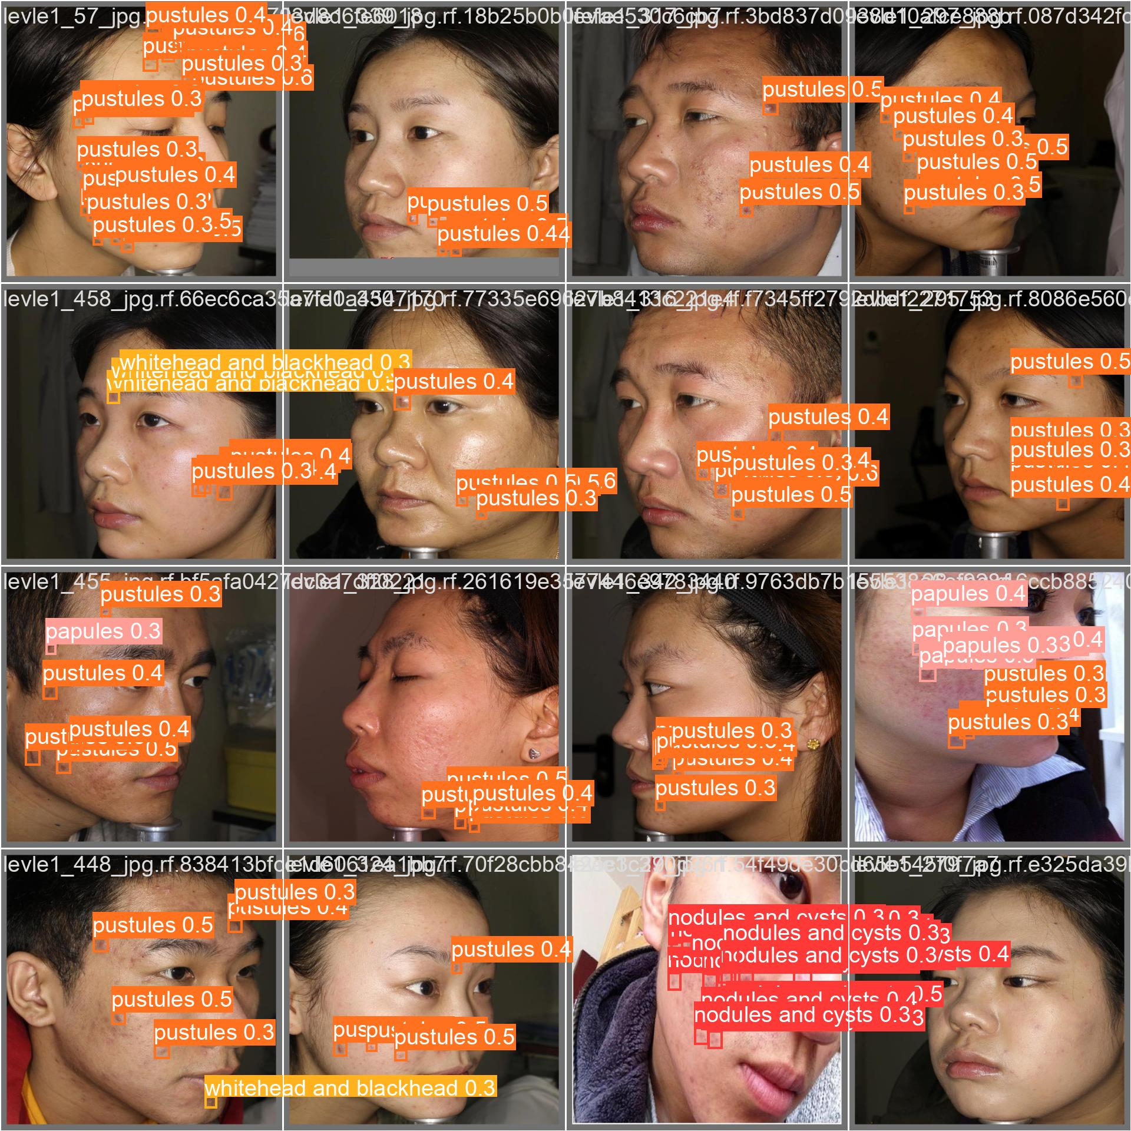
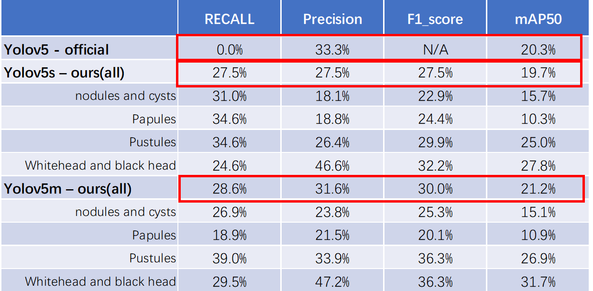
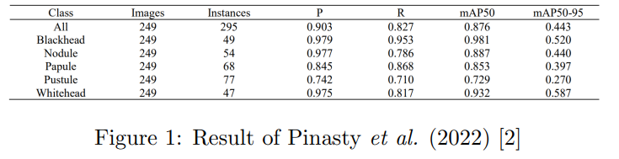
Yolov5 -Result Analysis
Result Conclusion
Prediction
Ground Truth
Result:
Results are close to the official version, with the official(robotflow) achieving a mAP@0.5 of 20.3%, while our best result is 21.2%. This indicates that our results are within the normal range.
Many acne instances are correctly boxed but misclassified. (As the prediction shows)
The training set loss continues to decrease, while the validation set loss starts to increase.- > overfitting
Analysis:
Compared to the official version, our model has a higher recall, likely due to data augmentation improving its detection ability. However, precision is lower, with many correct bounding boxes but incorrect labels. Both our version and the official version show relatively low mAP, indicating that the overall detection capability of the model is suboptimal.
Possible reason: Class Imbalance, Learning Rate Too High, data distribution bias between train/valid dataset, Batch Size Issues
Compared to Pinasty's results, where the mAP reached 87.6%, our model's performance is significantly lower, despite using the same acne dataset. Pinasty's dataset has a more balanced distribution, which highlights that our data imbalance is a key factor contributing to the poor performance.
a) Yolov5s
Training log
b) Yolov5m

Slide 3
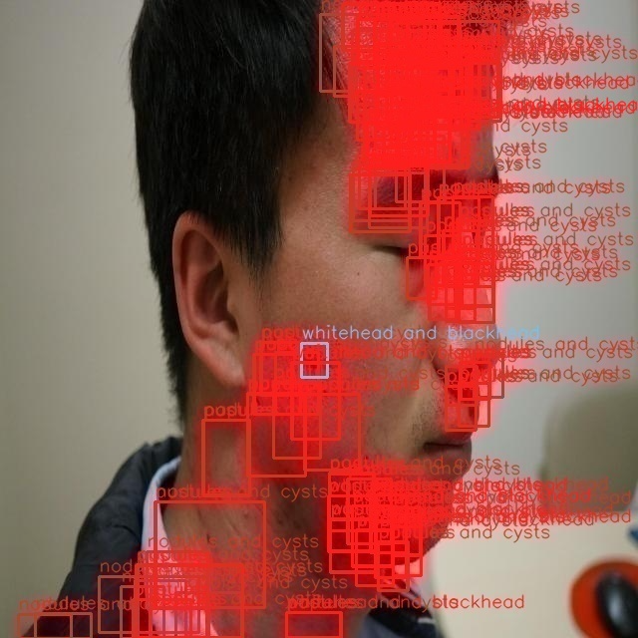
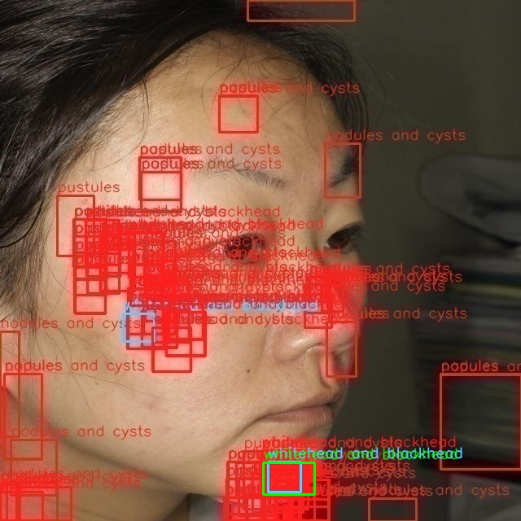
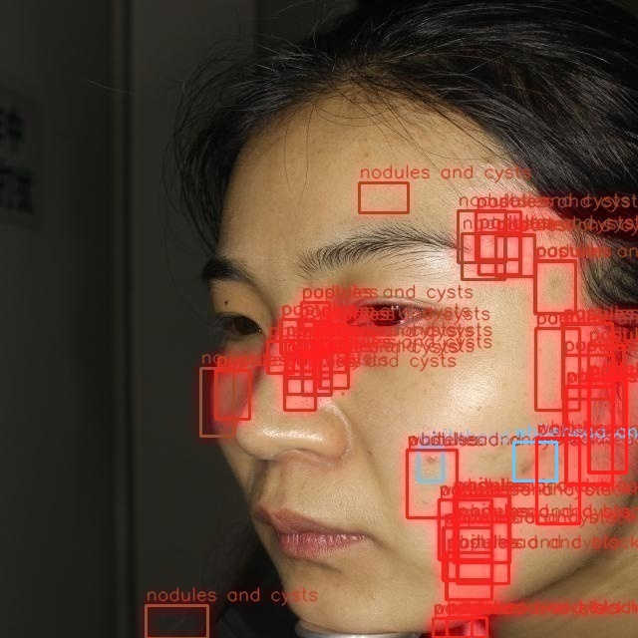
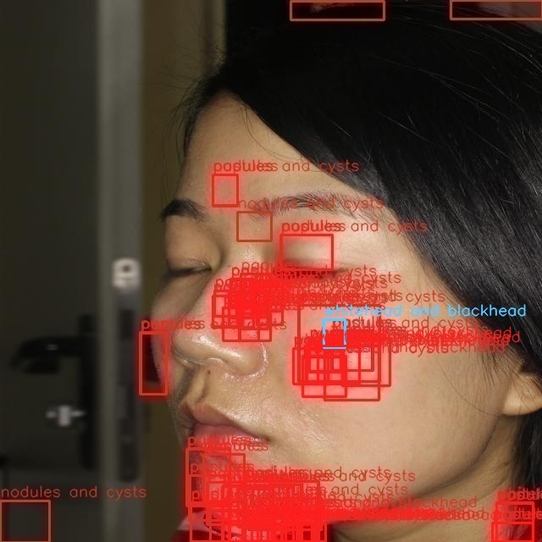
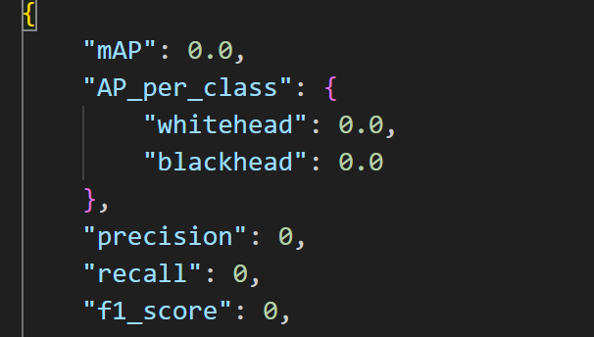
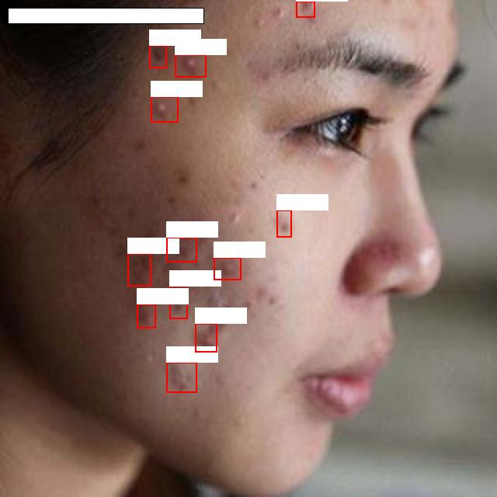
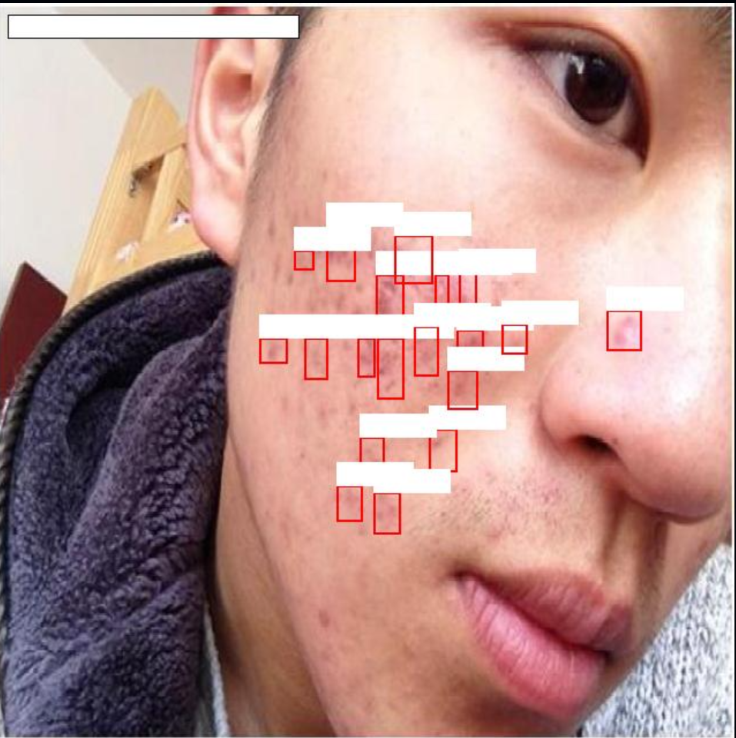
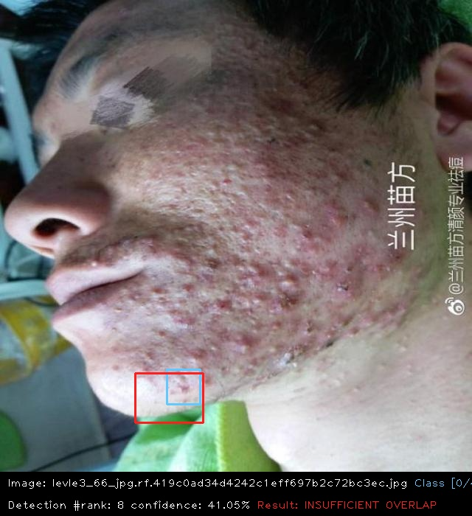
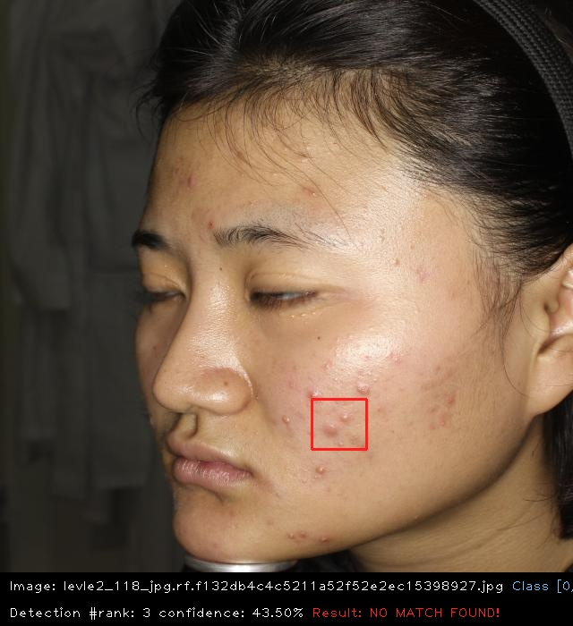
Faster-RCNN
Ridiculous version with all 0!!
Question: why all the evaluation result are zero??
Analysis:
Step1: check the result image
We found that there are a large number of redundant bounding boxes, and the correct areas have already been bounded. It is impossible to have a situation where the mAP is 0. This analysis indicates that the model is overfitted, and adjustments need to be made in future training.
Step2: check the evaluate code
Through investigation, it was found that there was an issue of label recognition misalignment in the evaluation code, causing all labels to fail to be verified correctly. Therefore, there were no acne samples with correctly annotated bounding boxes.
Result: By properly partitioning the dataset and implementing early stopping, we can achieve more reasonable results in future training.
Prediction with all box

Slide 4
Faster-RCNN
Resnet Result Conclusion
Vgg Result Conclusion
Result:
Faster - RCNN - resnet: Shows relatively balanced performance across all metrics (Precision, F1_score) for both overall and per - class results. Precision and F1_score values are at a moderate level. With an mAP50 of 12.3%, the differences in mAP50 among various classes are relatively small, demonstrating a certain detection capability for different categories (e.g., “Whitehead and black head”).
Faster - RCNN - vgg: Boasts a relatively high overall Recall (52.2%), but suffers from an extremely low Precision (3.9%), which in turn leads to a low F1_score (7.3%). The mAP50 fluctuates significantly across classes. While some classes (e.g., “nodules and cysts”) achieve a decent mAP50 (16.3%), the mAP50 for “Whitehead and black head” is only 3.5%, indicating poor detection stability for different target categories.
Analysis:
Recall - Precision Balance：ResNet - based Faster - RCNN leads in Precision and F1 - score, with fewer false positives. VGG - based one, despite high Recall, has very low Precision, causing many false positives and reducing practical value.
Per - Class Stability：ResNet shows smaller metric (mAP50, Recall, Precision) fluctuations across classes for balanced detection. VGG has unstable performance across classes, lacking robustness.
Overall Performance：Faster - RCNN - ResNet beats VGG - based in accuracy, class adaptability, and balance. VGG’s high false positives and unstable class detection make it less competitive, despite decent Recall.
Conclusion: Resnet better!

Slide 5
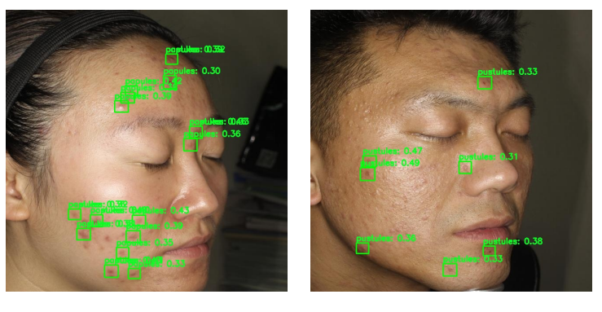
DINO & all
Model - Specific Characteristics
DINO: Demonstrates minimal performance variance across classes, making it suitable for multi - class balanced detection
Faster - RCNN - vgg: Tends to achieve extremely high recall for certain classes (e.g., large - sized, highly distinguishable lesions) but suffers from severe false positives when detecting small or ambiguous targets.
Yolov5 Series: Yolov5m outperforms Yolov5s, indicating that increased model complexity is more conducive to multi - class feature extraction. It is suitable for scenarios that demand a certain level of feature extraction depth while having limited computing power.
2. Overall Task Performance & Root Causes The detection results of the above three models for this task are generally sub - optimal. Through analysis, the reasons include the imbalance of our dataset and the models’ inherent limitations in detecting small targets. Among these, the dataset imbalance is the dominant factor and requires strengthening in future work.
ALL model Result Conclusion
DINO Result Conclusion
DINO Prediction

Slide 6
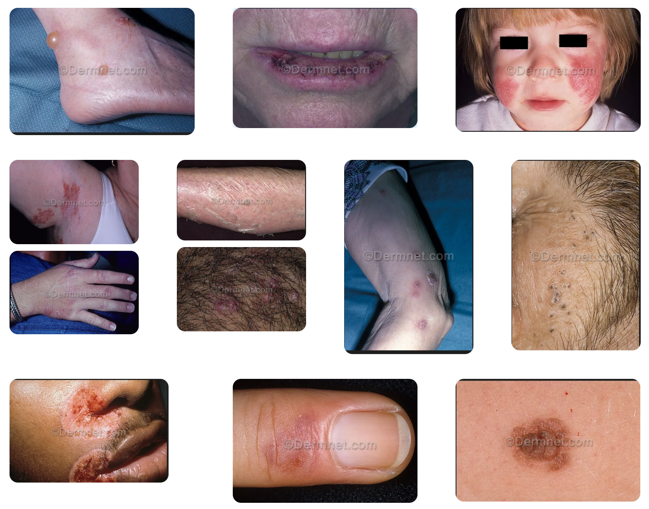
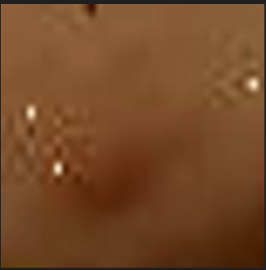
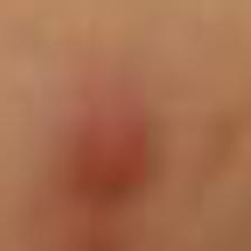
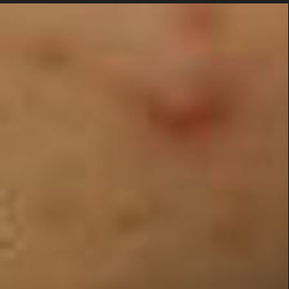
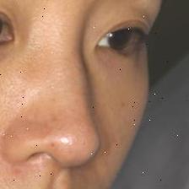
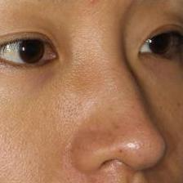
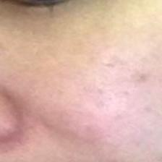
Cross-Domain Acne Classification
Positive sample patches(acne) from ACNE04
Negative sample patches(healthy skin) from ACNE04
Dermnet cases
Acne04
Raw dataset analysis(Acne04 vs. Dermnet):
DermNet: Contains data for 23 major categories of skin diseases, with acne being one of them, accounting for less than 5% of the total dataset. Additionally, the dataset contains a large number of cases on the face, limbs, and trunk, with complex lighting conditions, inconsistent clarity, and watermarks. One particularly challenging category is: Warts Molluscum and other Viral Infections.These lesions often exhibit circular or raised features that superficially resemble acne, leading to possible misclassification.
Acne04： Data primarily focuses on the patient's face, with clear lesions.
Dataset Creation -> Patch-based Strategy: Positive and Negative Sampling:
Use the YOLOv5-compatible ACNE04 dataset, where each facial image includes bounding box annotations for acne lesions. To maximize annotation accuracy and train a robust classifier, we adopt a positive-negative cropping strategy on each image
✅ Positive Patches: Directly cropped from acne bounding boxes to provide highly accurate samples,
❌ Negative Patches: 1. Sampled randomly from the same image, ensuring no overlap with acne boxes.
2. The number of negative patches is 2~3× more than positives.
3. Sampled only from the central region of the face.This avoids selecting irrelevant background or out-of-face areas.
reliable, annotated data + Helps the model focus on skin texture, color difference, and acne inflammation details + patches differ only by acne presence

Slide 7
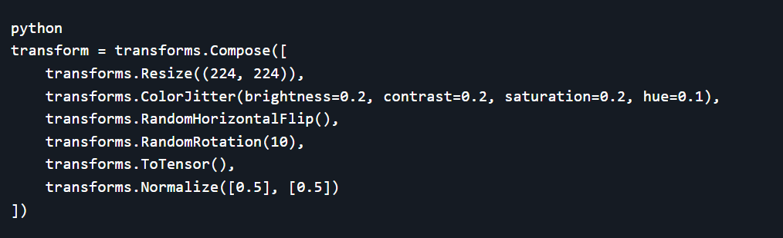
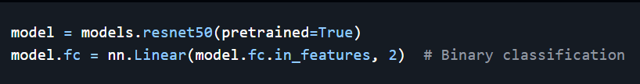
Cross-Domain Acne Classification
Enhancing Skin Awareness: Color & Texture + Backbone
Color Contrast Awareness:
Acne is often distinguished by redness, discoloration, or pigmentation. We apply ColorJitter during data augmentation to make the model sensitive to these features.
Texture Feature Enhancement:
Acne lesions differ in surface texture (bumps, edges). To better capture these features, we use a deeper backbone network:
Why ResNet50?
Compared to ResNet18, ResNet50 offers stronger feature extraction for: Local skin textures + Edges and contours + Robustness in cross-domain scenarios
All in all, ResNet50 is a better choice for our task.

Slide 8
Cross-Domain Acne Classification - Model Design(Model & Analysis)
V3: Facenet + Three Augmentations
Model: Building on the first version, our goal is to Simulate texture shift, occlusion, and blur. To validate whether HSV + Cutout + Affine further improve results
Result: V3 shows a improvement in AUROC(Compare to v1), which indicates better performance in distinguishing classes even though it still fails to detect positive instances (0% recall)
V3-weighted : Facenet + Three Augmentations (Paper Method)
Model: Same as V3. But 1:1 balanced dataset of ACNE and non-ACNE samples
Result: V3 aligns slightly better with real-world sparsity (its AUROC is marginally higher than V3_weighted). However, 0 recall and 0 Precision shows the model the model fails entirely at detecting positive samples
V1: Facenet
Model: We train a binary classifier to distinguish between acne (positive) and normal (negative) skin patches using image-level labels. Natural imbalanced dataset.
Result: Despite high accuracy, the model fails entirely at detecting positive samples, leading to 0 precision, recall, and F1 score — a typical symptom of severe class imbalance (i.e., only predicting negatives correctly).
Conclusion!
Model / Data: We should use V2 as our base model. Besides, our experiment shows that train with natural imbalanced dataset can perform better in cross-domain detection task, since it is more close to the reality.
Analysis: Simply implementing data augmentation methods is not sufficient to effectively improve precision in cross-domain tasks, as it only enhances performance on the original dataset. To address this, we introduced CycleGAN to allow the Acne04 dataset to learn the features of the DermNet dataset, thereby improving domain adaptation and boosting model performance in cross-domain tasks.
V2: Facenet + Basic Augmentations
Model: Building on the first version, our goal is to generalize skin tone and pose. To achieve this, we added basic augmentations such as Color, Blur, Rotation, Flip, and Crop. Natural imbalanced dataset.
Result: V2 shows a significant improvement in AUROC, which indicates better performance in distinguishing classes even though it still fails to detect positive instances (0% recall)
V2-weighted : Facenet + Basic Augmentations
Model: Same as V2. But 1:1 balanced dataset of ACNE and non-ACNE samples
Result: The imbalanced training set (V2) performed slightly better than the balanced one (V2_Weighted) in terms of AUROC (0.5268 vs. 0.5076), despite both achieving high accuracy but poor recall/precision due to label sparsity. Artificially balancing the dataset (as in V2_Weighted) may hinder generalization by overfitting to rare positive samples.
CycleGAN Time !!!

Slide 9
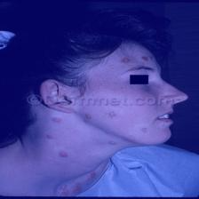
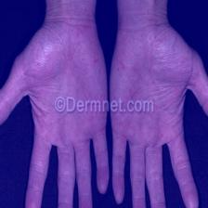
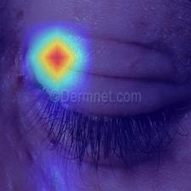
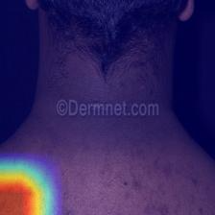
Cross-Domain Acne Classification – CycleGAN Version
CycleGAN-based Acne Image Style Transfer and Training
Model: Based on the previous tset, we find V2 is the best version. We use the dataset transformed by the Dermnet.
Data process:
1. Acne data selection: Selected 1000 positive and 1000 negative acne patches from YOLOv5-split data
2. DermNet Image Selection: Randomly selected 10 positive(select from acne folder) and 10 negative images(select from non –acne folder) from DermNet/train, then augmented to 1000 images each [ The task mentioned we can only use 20 image from Dermnet to help assess domain gap]
3. Separately train the CycleGAN Model with positive patches and negative patches. Then use StyleTransfer to let the Acne dataset became a Dermnet Style. Remixed the transfer data and raw data to train.
Result: CycleGAN significantly improves recall (43.91%) and AUROC (62.06%), which are key indicators of the model's ability to detect and distinguish positive instances across domains. This CycleGAN-based approach provides a novel way to enhance acne image classification by bridging domain gaps with style transfer, improving model performance and generalization on diverse acne image sources.
CycleGAN Results: Accurate Predictions and Grad-CAM

